Slide 1


Music Store
SQL Database

Slide 2
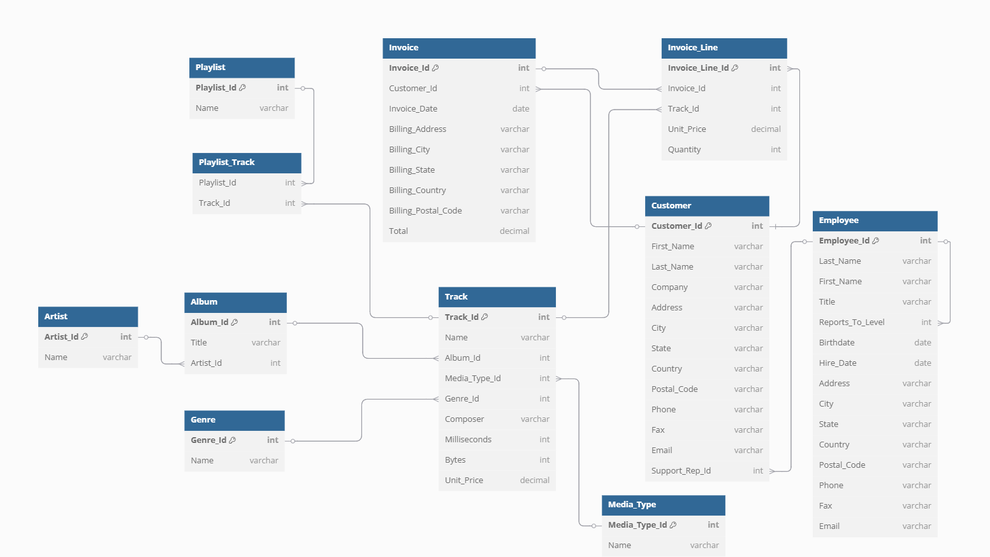

Slide 3
1. Who is the senior most employee based on job title?
Select * From Employee
Order By Level Desc
Limit 1;

Slide 4
2. Which countries have the most Invoices?
Select Billing_Country,
Count(*) as Total_Invoices
From Invoice
Group By Billing_Country
Order By Total_Invoices Desc;

Slide 5
3. What are top 3 values of total invoice?
Select Total From Invoice
Order By Total Desc
Limit 3;

Slide 6
4. Which city has the best customers? We would like to throw a promotional Music Festival in the city we made the most money. Write a query that returns one city that has the highest sum of invoice totals. Return both the city name & sum of all invoice totals
Select Billing_City,
Sum(Total) As Invoice_Total
From Invoice
Group By Billing_City
Order By Invoice_Total Desc;

Slide 7
5. Who is the best customer? The customer who has spent the most money will be declared the best customer. Write a query that returns the person who has spent the most money
Select Customer.Customer_Id, Customer.Full_Name,
Sum(Invoice.Total) as Invoice_Total
From Customer
Join Invoice
On Customer.Customer_Id = Invoice.Customer_Id
Group By Customer.Customer_Id,
Customer.Full_Name
Order By Invoice_Total Desc
Limit 1;

Slide 8
1. Write query to return the email, first name, last name, & Genre of all Rock Music listeners. Return your list ordered alphabetically by email starting with A
Select Distinct
Customer.Email,
Customer.First_Name,
Customer.Last_Name,
Genre.Name As Genre
From Customer
Join Invoice on Customer.Customer_Id = Invoice.Customer_Id
Join Invoice_Line on Invoice.Invoice_Id = Invoice_Line.Invoice_Id
Join Track on Invoice_Line.Track_Id = Track.Track_Id
Join Genre on Track.Genre_Id = Genre.Genre_Id
Where Genre.Name = 'Rock'
Order By Customer.Email Asc;

Slide 9
2. Let's invite the artists who have written the most rock music in our dataset. Write a query that returns the Artist name and total track count of the top 10 rock bands
Select
Artist.Name as Artist_Name,
Count(Track.Track_Id) as Total_Rock_Tracks
From Artist
Join Album on Artist.Artist_Id = Album.Artist_Id
Join Track on Album. ALbum_Id = Track.Album_Id
Join Genre on Track.Genre_Id = Genre.Genre_Id
Where Genre.Name = 'Rock'
Group By Artist.Name
Order By Total_Rock_Tracks Desc
Limit 10;

Slide 10
3. Return all the track names that have a song length longer than the average song length. Return the Name and Milliseconds for each track. Order by the song length with the longest songs listed first
Select
Name as Track_Name,
Milliseconds
From Track
Where Milliseconds >(
Select Avg(Milliseconds) From Track
)
Order By Milliseconds Desc;

Slide 11
1. Find how much amount spent by each customer on artists? Write a query to return customer name, artist name and total spent
Select
Customer.Full_Name,
Artist.Name as Artist_Name,
Round(Sum(Invoice_Line.Unit_Price * Invoice_Line.Quantity),2) as Total_Spent
From Customer
Join Invoice on Customer.Customer_Id = Invoice.Customer_Id
Join Invoice_Line on Invoice.Invoice_Id = Invoice_Line.Invoice_Id
Join Track on Invoice_Line.Track_Id = Track.Track_Id
Join Album on Track.Album_Id = Album.Album_Id
Join Artist on Album.Artist_Id = Artist.Artist_Id
Group By Customer.Full_Name, Artist_Name
Order By Total_Spent Desc;

Slide 12
2. We want to find out the most popular music Genre for each country. We determine the most popular genre as the genre with the highest amount of purchases. Write a query that returns each country along with the top Genre. For countries where the maximum number of purchases is shared return all Genres
With Genre_Purchase_Count As (
Select
Customer.Country,
Genre.Name As Genre,
Count(*) As Total_Purchases
From Customer
Join Invoice On Customer.Customer_Id = Invoice.Customer_Id
Join Invoice_Line On Invoice.Invoice_Id = Invoice_Line.Invoice_Id
Join Track On Invoice_Line.Track_Id = Track.Track_Id
Join Genre On Track.Genre_Id = Genre.Genre_Id
Group By Customer.Country, Genre.Name
),
Max_Purchases_Per_Country As (
Select
Country,
Max(Total_Purchases) As Max_Purchases
From Genre_Purchase_Count
Group By Country
)
Select
gpc.country,
gpc.genre,
gpc.total_purchases
From Genre_Purchase_Count gpc
Join Max_Purchases_Per_Country mpc
On gpc.country = mpc.country And gpc.total_purchases = mpc.max_purchases
Order By gpc.country Asc, gpc.genre Asc;

Slide 13
3. Write a query that determines the customer that has spent the most on music for each country. Write a query that returns the country along with the top customer and how much they spent. For countries where the top amount spent is shared, provide all customers who spent this amount
With Customer_Total_Spent As (
Select
Customer.Country,
Customer.Customer_Id,
Customer.Full_Name,
Round(Sum(Invoice.Total), 2) As Total_Spent
From Customer
Join Invoice On Customer.Customer_Id = Invoice.Customer_Id
Group By Customer.Country, Customer.Customer_Id, Customer.Full_Name
),
Max_Spent_Per_Country As (
Select
Country,
Max(Total_Spent) As Max_Spent
From Customer_Total_Spent
Group By Country
)
Select
cts.country,
cts.full_name,
cts.total_spent
From Customer_Total_Spent cts
Join Max_Spent_Per_Country mspc
On cts.country = mspc.country And cts.total_spent = mspc.max_spent
Order By cts.country Asc, cts.full_name Asc;

